Slide 1


Group work on Medical IR
Georgios Peikos, Wojciech Kusa, Annisa Maulida Ningtyas

Slide 2
Agenda
Introduction of Information Extraction
Information Extraction Related Task
Health Ontology
MedCAT – Medical Concept Annnotation Tool

Slide 3
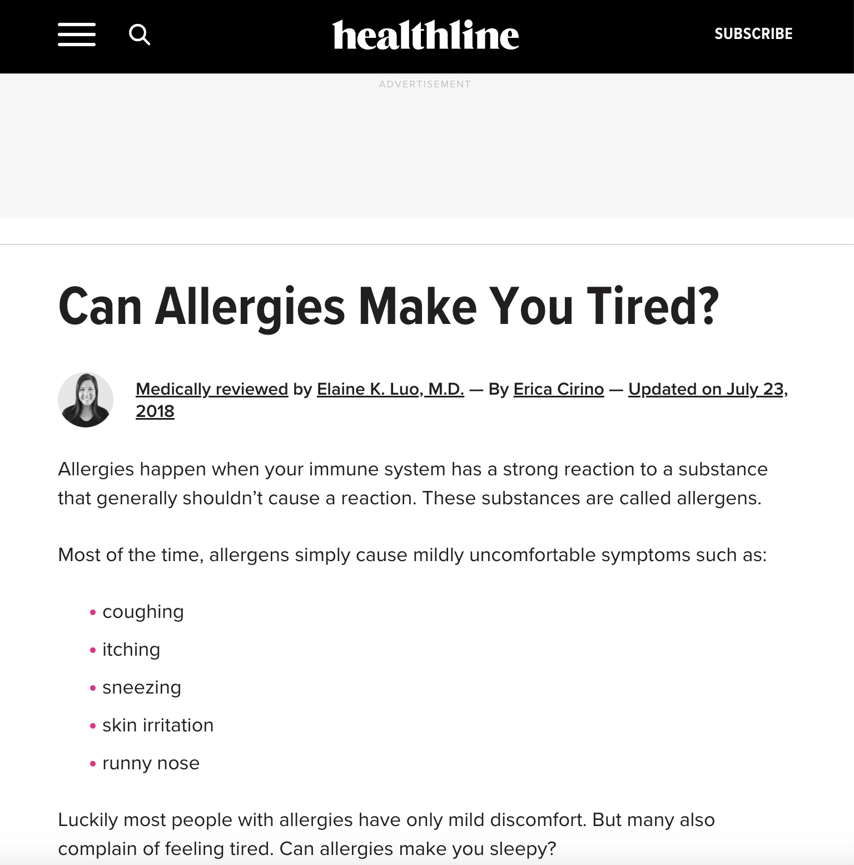
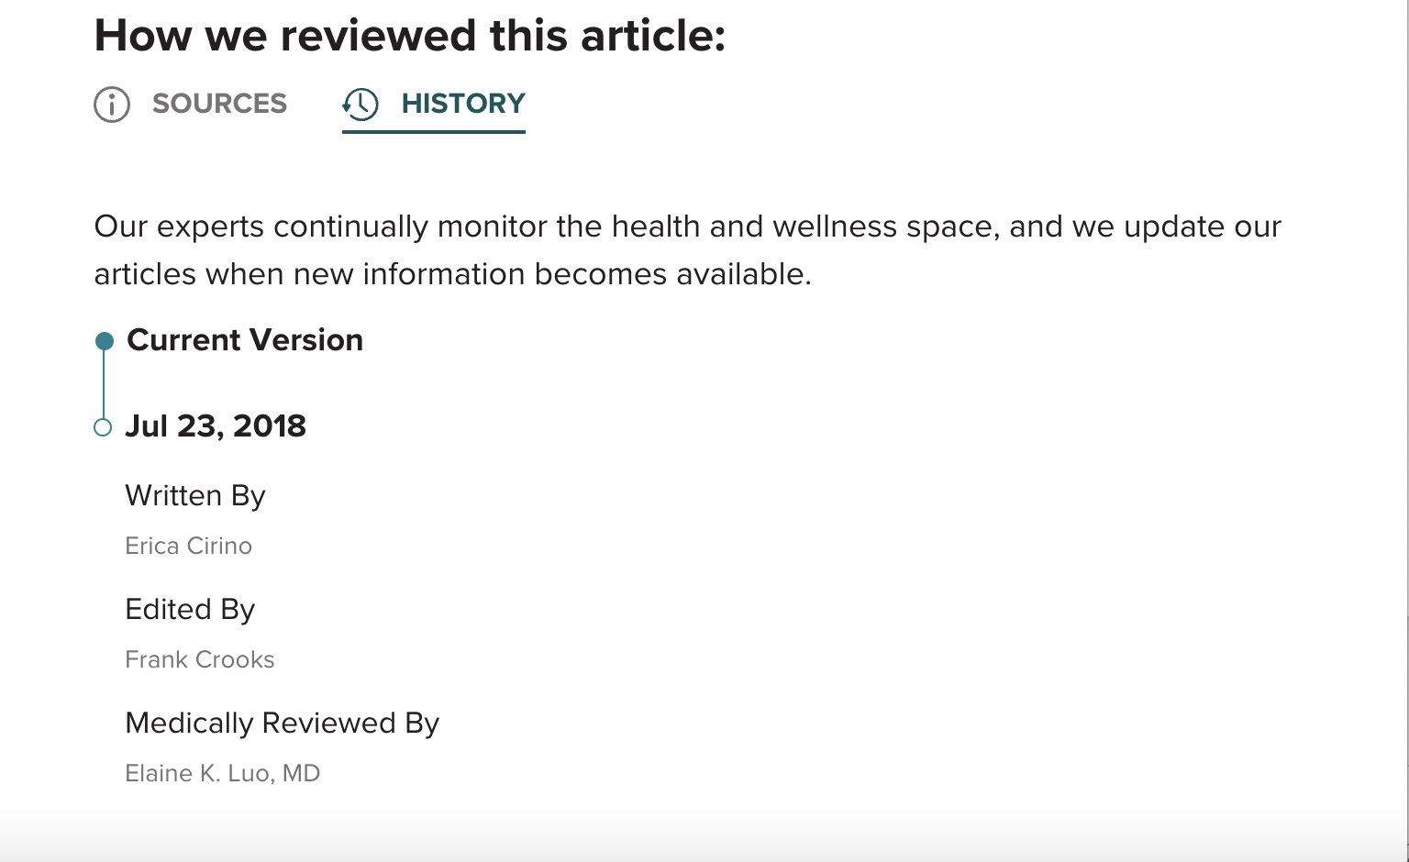
From unstructured to structured form
Allergies could makes fatigue
Author: Erica Cirino
Reviewer: Elaine K. Luo MD

Slide 4
What is Information Extraction?
Information Extraction – identify and extract instances of fields of interest from unstructured or semi-structured text and convert to structured representation
Field of interest could be named entities, relations, or events
Known by many others name - named entity extraction, knowledge base population, attribute extraction, ..

Slide 5
Information Extraction Related Tasks
Identify medical concepts: Named Entity Recognition (NER)
`chest pain`
Identify medical concepts link to medical KB: Medical Concept Normalization
`chest pain` - ´chest pain (SCUI: 29857009)`
`MRI` - `Magnetic Resonance Imaging (SCUI: 113091000)`
Identify relationships between concepts: Relationship Extraction
Treats(Prozac, clinical depression)
Causes(cataract, decreased vision)
Extract assertions, attributes values
Blood pressure: high, low, normal
Tumor: absent, benign, malignant, in-situ, un-known
Identify protected health information: De-identification
Patient name, clinician’s name
DoB, Date of clincal encounter
`MRI`

Slide 6
Information Extraction Related Tasks
Identify medical concepts: Named Entity Recognition (NER)
`chest pain`
Identify medical concepts link to medical KB: Medical Concept Normalization
`chest pain` - ´chest pain (SCUI: 29857009)`
`MRI` - `Magnetic Resonance Imaging (SCUI: 113091000)`
Identify relationships between concepts: Relationship Extraction
Treats(Prozac, clinical depression)
Causes(cataract, decreased vision)
Extract assertions, attributes values
Blood pressure: high, low, normal
Tumor: absent, benign, malignant, in-situ, un-known
Identify protected health information: De-identification
Patient name, clinician’s name
DoB, Date of clincal encounter
`MRI`

Slide 7
An Example: Find all medical concepts
The patient is a 63-year-old female with a three-year history of bilateral hand numbness and occasional weakness.
Within the past year, these symptoms have progressively gotten worse, to encompass also her feet.
She had a workup by her neurologist and an MRI revealed a C5-6 disc herniation with cord compression and a T2 signal change at the level

Slide 8
Relevant entities in medical record
Disease: symptoms, problems, signs, conditions
Treatment: medication, surgery, procedure, follow-up
Test: blood work, lab work
Anatomical sites: body parts, regions,
Chemical agent: drugs, substance, ..
…….

Slide 9
Health Ontology – SNOMED CT
SNOMED CT is a clinical terminology
Systematized Nomenclature of Medicine (Clinical Terms)
Collection of names and words
Relevant to the field of medicine
Organised in a structured and logically consistent manner
Standardized, multilingual vocabulary of clinical terminology used for electronic exchange of clinical health information
More ‘like’ a thesaurus than just a coding scheme

Slide 10
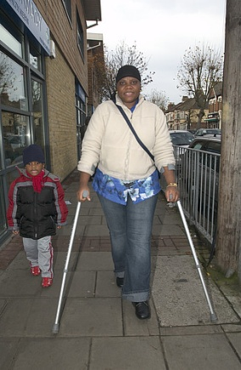
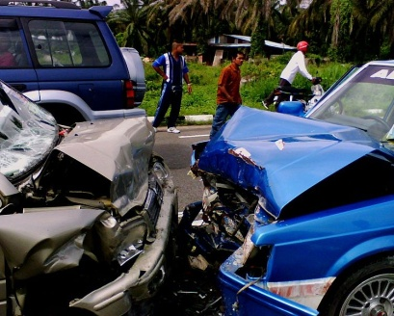
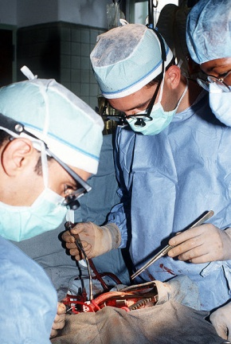
SNOMED CT Content
Clinical Findings
Disease and deformity – scar
Symptoms – difficulty breathing
Causes of Disease
Forces – pressure change
Events – road traffic accident
Procedures
Laboratory
Therapy
Examination findings – tachycardia
Organisms – herpes simplex virus
Surgical procedure
Social – finding of walking aid use
Clinical Investigation

Slide 11
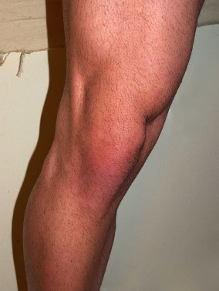

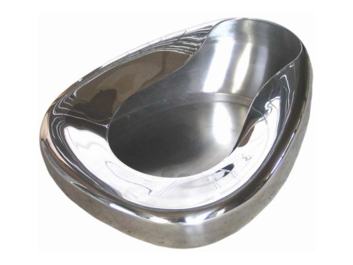
SNOMED CT Content
Anatomy
Normal – knee joint
Abnormal – ganglion cyst
Observations
Vital signs – blood pressure
Body product observable – colour of urine
Products
Drugs – paracetamol
Substances – latex
Devices – bedpan
Lesions – bony callus
Values - present

Slide 12
A Concept in SNOMED CT
Codes and descriptions
Relationships
Is a
Qualifiers & values
Attributes

Slide 13
A Concept in SNOMED CT
Preferred Term: Heart Disease
Synonym: Cardiopathy
Synonym: Disorder of Heart
Synonym: Morbus Cordis
Synonym: Cardiac Disorder
Synonym: Cardiac Diseases
Synonym: Heart Diseases
Heart disease (disorder) 56265001
Relationships
Is a cardiac finding
Is a disorder of mediastinum
Is a disorder of cardiovascular system
Finding site heart structure
Severity
Episodicity
Courses

Slide 14
SNOMED-CT Browser tool
https://browser.ihtsdotools.org/?perspective=full&conceptId1=404684003&edition=MAIN/2021-07-31&release=&languages=en

Slide 15
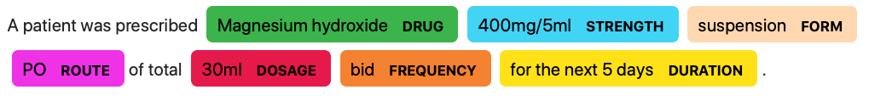
IE Techniques - NER
A patient was prescribed Magnesium hydroxide 400mg/5ml suspension PO of total 30ml bid for the next 5 days

Slide 16
Medical NER Tools
Spacy¹
Scispacy²
METAMAP³
MedCAT⁴
…
¹https://github.com/explosion/spaCy
²https://allenai.github.io/scispacy/
³https://lhncbc.nlm.nih.gov/ii/tools/MetaMap.html
⁴https://github.com/CogStack/MedCAT

Slide 17
MedCAT - Medical Concept Annotation Tool
An open-source NER and Linking (NER+L) and an annotation tool and online learning training interface.
Use to extract information from Electronic Health Records (EHRs) and link it to biomedical ontologies like SNOMED-CT and UMLS.
Zeljko Kraljevic, Thomas Searle, Anthony Shek, Lukasz Roguski, Kawsar Noor, Daniel Bean, Aurelie Mascio, Leilei Zhu, Amos A. Folarin, Angus Roberts, Rebecca Bendayan, Mark P. Richardson, Robert Stewart, Anoop D. Shah, Wai Keong Wong, Zina Ibrahim, James T. Teo, Richard JB. Dobson

Slide 18
MedCAT Workflow
Input text
NER
Entity Linking
Annotated input text
The patient is a 63-year-old female with a three-year history of bilateral hand numbness and occasional weakness.
Bilateral
Hand numbness
Occasional
Weakness
…
Right and left (scui: 51440002)
Numbness of hand (scui: 13791008)
Occasional (scui: 84638005)
Asthenia (scui: 13791008)
…
The patient is a 63-year-old female with a three-year history of bilateral hand numbness and occasional weakness.

Slide 19
MedCAT Demo
https://medcat.rosalind.kcl.ac.uk/

Slide 20
Reference
The content of this slides are taking from coursera course: ‘Information Extraction from Free Text Data in Health’
https://www.coursera.org/learn/information-extraction-from-free-text-data-in-health-2/

